Slide 1

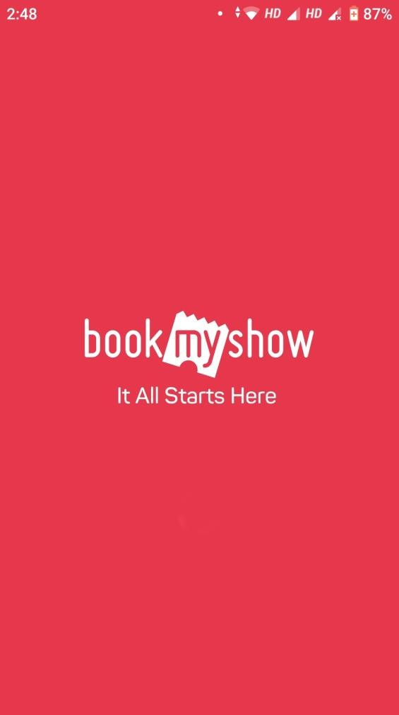
Subhadip Samanta
IIFT Delhi

Slide 2
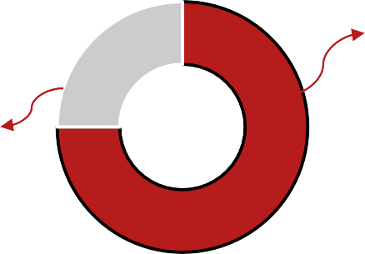
Problem Statement
BookMyShow is the largest ticketing platform in India. The main source of business for BMS is events/tickets sales. Due to Covid, this category is not doing well. Also, multiplexes and concerts don’t seem to be resuming any time soon.
Our Goal
TO REMAIN RELEVANT IN THE CURRENT SCENARIO BY IMPROVING EXISTING FEATURES AND ADDING NEW FEATURES
Target Segment & Pre-Covid Market Share
4%
Online Ticket Booking
Market Share in Online Ticketing
Book My Show
75%
Paytm
~25%
10%
12 Million
Tickets Sold Per Month
30 Million
Active Users Per Month
On Ground Ticketing
17%
56%
Live Events
13%
Turnkey Ticketing Solution
Ads & Marketing

Slide 3



User Persona
Abhijit, 24, Mumbai
Sports & video games buff
Follows sports & online communities online
Munmun, 28, Bangalore
Wants to try out different hobbies, self teaches herself and try to perfect it
Searches for avenues to seek assistance from tutors from the comfort of home for multiple hobbies
Raunaq, 35, Delhi
Movie and TV Shows fanatic
Loves to interact with fellow followers on online communities, follow conversations on social media
Makes sure he watches first day first show of new releases
gaming
Buy passes for almost every sports event in the city
User Journey
Searches for the movie OR
Checks for any applicable
offers & checksout
Opens App
Browses the section for
Click on Buy/Register
events/workshops

Slide 4
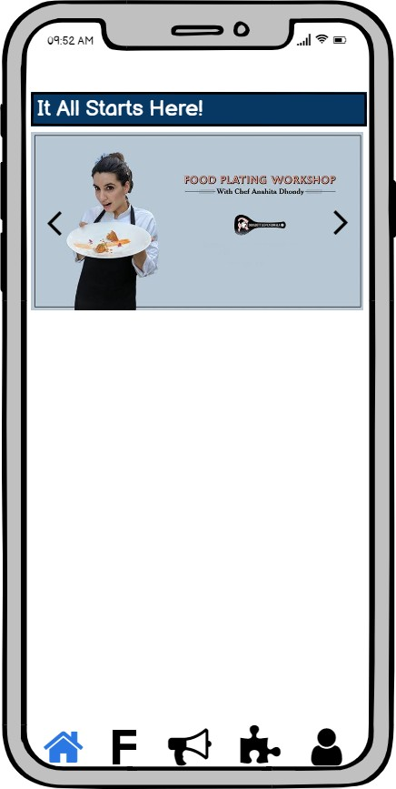
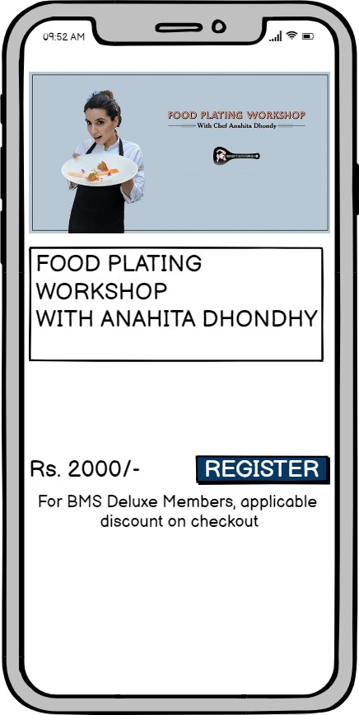
Improved Feature 1 – Partnership with Influencers
(HIGHEST VALUE SOLUTION)
Feature Description Partnerships with Influencers/Celebrities to
Macro
conduct
The workshops with famous macro influencers/celebrities will be showcased on the first page, as well as in the respective sections (like this one in Cooking), in the app
The BMS Deluxe users will be given special discounts OR some bundled products (like an exclusive recipe), so as to nudge users to purchase the pass
workshops, exclusively on BookMyShow
Insights
For every $1 that brands spend on
influencers, they are getting an ROI of $5.78.
Value Proposition to Users
Users will be more eager to attend workshops hosted by their favourite influencer/celebrity, and will relate more to the content
Influencers/Celebrities already host such workshops regularly on Instagram – We will be giving them an exclusive platform for the same
Expected Output for Book My Show
Increased sign ups
Increase in ARPU
Increased Retention
Metrics to consider
Registrations/Month Registrations each section/month
Average Revenue/User

Slide 5
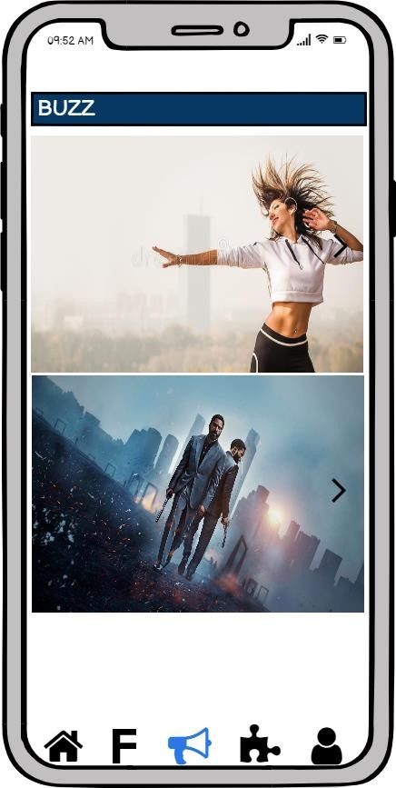
Improved Feature 2 – Content & format improvement on Buzz
Feature Description
Along with trending topics, inclusion of content on Buzz which will nudge the users to buy passes for events
Placards, instead of full-written blogs to provide content in crisp manner
The content on buzz has to be relevant to the
workshops/events that are on app.
This is how Zumba helps you tone your body!
For example, the content on dancing will push the users to purchase tickets for such event or workshop, the details of Zumba event will be present at the end of the content which will redirect the user to the said event’s page.
Insights
Content marketing provides conversion rates about 6 times higher than other digital marketing methods
Average attention span time of user is around 8 seconds
278
10 Things to know before watching Tenet
Since attention span is decreasing, instead of blog, the content should be in form of stories/placards which could be swiped right or left.
130
The user should be able to like as well, most liked content will be pushed at the top. The views will enable user to know how many others have read the content, and make them more interested to read.
Value Proposition to Users
Through workshops/event specific content, users will realise the importance of a particular skill/workshop and will be nudged to try it out
Placards will grab instant eyeballs and enable user to go through their favourite topic in seconds, rather than reading long blogs
Expected Output for Book My Show
Metrics to consider
Increased sign ups
Increase in user engagement
Increase in ARPU
Increase in avg. session time per user
Daily Active Users
Avg. views per blog/content
Avg. likes per content
Increase in redirection to events from Buzz

Slide 6
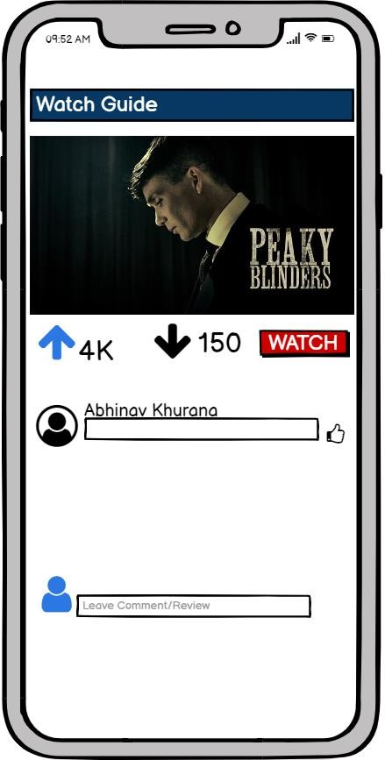
Improved Feature 3 – Social engagement on Show Guide
Feature Description
User engagement through reviews/recommendations from friends and followers on Show Guide
Unlock achievements in form of badges to users
Insights
92% consumers trust their friends and peers before trying out a product/service
Value Proposition to Users
Apart from their own friends, people will be able to follow others as well who drop in good comments, reviews/recommendations
They will be able to follow genres they love to watch, and get more recommendations on the basis of that
Users will find reviews from their friends
more reliable
Will be provided with badges for bingers on unlocking achievements which they can compare with their friends on leaderboard
Most people watch TV shows and movies on peer recommendations, hence social engagement is necessary
Since in profile, the user has been given the
option to sync with their fb profile, their
friend’s comments and recommendations will
be shown.
The user will be able to follow other users as well to look at their reviews. They’ll be able to upvote and comment too.
Users will also be able to track how many movies and TV Shows they have watched yet, and will be able to compare their achievement on leaderboard with friends and followers
MARK IT AS WATCHED
Expected Output for Book My Show
Metrics to consider
Upvotes/User & Downvotes/User
Contacts synced/User & People Followed/User
Watched content/User
Comments/Month
Increased engagement
Increased retention
Increase in avg. time per session

Slide 7
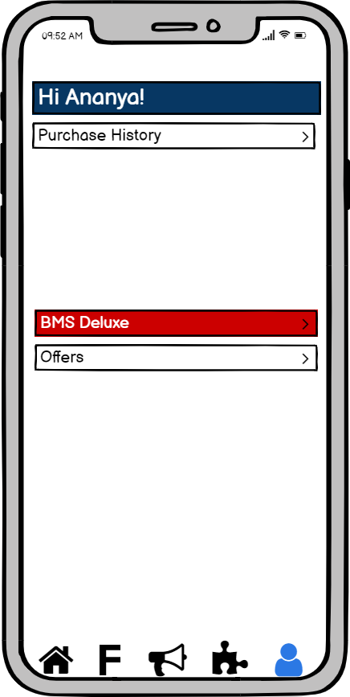
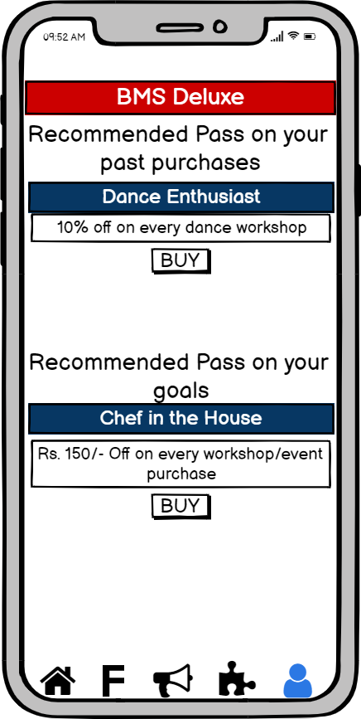
New Feature 1 – BMS Deluxe
Feature Description
Deep Discounts for loyalists will help Book My Show be the Go to platform for booking tickets
Insights
Loyalty programs increase retention by 5%, revenue by 25%-95%
Value Proposition to Users
Users can buy loyalty passes as per their
requirement.
The passes will be for different personas
– like baking buffs, theatre lovers, fitness fanatics, etc.
Passes will be bought by users for particular category. Also, general passes will be available too
Expected Output for Book My Show
Increased purchase frequency
Increased avg. time between purchases
Increased avg. order value
Increase in loyalty
The BMS Deluxe will be present in the profile section
The customized passes (based on past purchases, habits) will be shown first, after which all other passes will be shown
In case a user has already bought a pass earlier, those details will be shown first, with details about their savings through their pass, post which all passes will be shown
Metrics to consider
Redemption Rate
Renewals/Month
First time purchase/Month

Slide 8
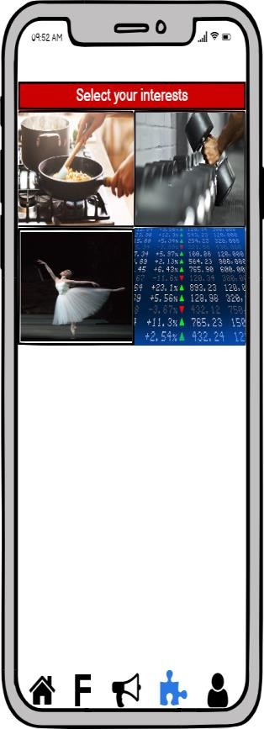
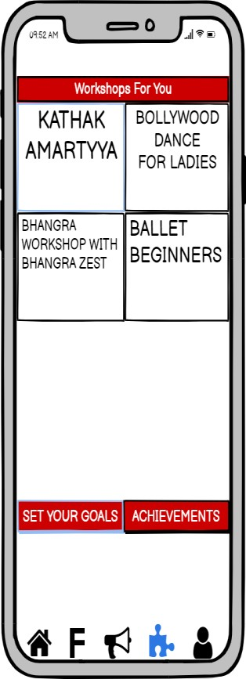
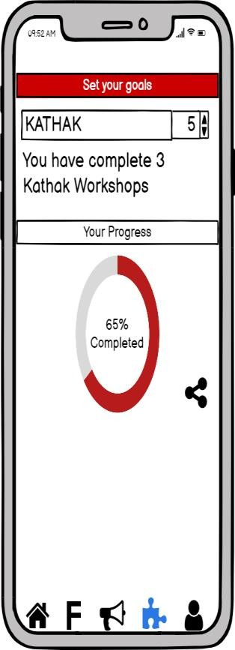
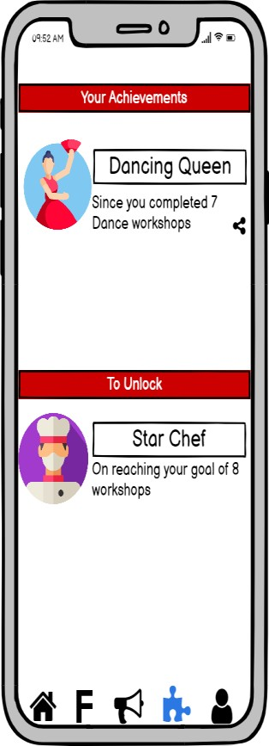
New Feature 2 – Goal Setting & Achievements
Feature Description
Goal setting for workshops/events/TV Shows
which will show their progress to users
Insights
Allowing users to complete achievements within the app turns occasional visitors to loyalists.
Value Proposition to Users
Users will be given the option to select hobbies they would want to pursue, and will be given recommendation of events and workshops based on selection
Their progress will be shown to them as they complete the sessions/workshops, with achievement badges which can be shared on social media, the locked badges will give them incentive to attend more workshops & events
Expected Output for Book My Show
Increased user retention
Increased loyalty
Increase in purchases
The user can select the hobbies/goals they want to achieve. Options will be based on tickets the app provides
Here, user can choose what hobby they want to pursue in particular.
Multiple can be added as
On setting the goal, user can see their progress for that skill, which can be shared on social media
Badges of achievements for the no. of events/workshops they attend.
well
Metrics to consider
Goals set/User Achievement Badges/User
Badge Shares/Month Average Revenue/User

Slide 9

Cost-Benefit-Risk Analysis
COST
BENEFIT
RISK
Reward Management Support & Development Cost Promotion Cost | Increased avg. order value Retention Increased ARPU Increased Purchase Frequency | Low Adoption Rate
Development Cost Design Cost | User Engagement Increased loyalty Increased Purchase Frequency | Heavy feature in terms of app space Low Adoption Rate Customized tracking difficult
Marketing Cost Collaboration Cost | Growth in users Retention Rate Increased ARPU | High Cost, High Reward Costs might go higher than revenue
Development & Design Costs | User Engagement Increased avg. session time | Less redirection towards events/workshops
Data Storage Cost Platform Modification Cost | User Engagement NPS Loyalty + Retention Increased avg. session time | Users unwilling to sync contacts Inconvenience to users due to high notifications
BMS Deluxe
Goal Setting &
Achievements
Partnership with
Influencers/Celebrities
Content & Format Improvement on Buzz
Social Engagement on
Show Guide

Slide 10
Metrics Negatively Impacted
Overall Metrics
1. Churn Rate : If churn rate is going up, Book My Show must analyse what kind of users they are losing. As per their past purchase trends, the users must be offered customized deals/discounts through mails or notifications (in case the app is still installed), to bring them back.
ARPU
Purchase Frequency
2. Bounce Rate : Bounce rate must be analysed per
page/feature-wise, looking at user journeys, to understand if a particular feature is experiencing maximum bounce rate, it should be improved accordingly. This goes for landing pages as well, if the correct pages are linked or not.
Stickiness
3. Monthly Revenue : If the Cumulative Revenue is going down, per feature revenue must be considered to see which feature is doing well and which is not.
Repeat Purchase Frequency
4. LTV:CAC Ratio : This is to understand how much company is spending to maximise growth and revenue, on acquiring customer. If it’s low, company needs to evaluate to cut down costs on customer acquisition
User Retention Rate

Slide 11
THANK YOU!

